Slide 1

Academic Session 2025-26
ODD Semester Jul-Dec 2025
UNIVERSITY INSTITUTE OF ENGINEERING
COMPUTER SCIENCE ENGINEERING
Bachelor of Engineering
Semester: 6th
Design and Analysis of Algorithms
(23CSH-301/ITH-301)
Unit No. 1 Chapter No. 2 Lecture No.7
Topic : Arrays, Stack
Richa Dhiman E11307 Assistant Professor

Slide 2
1
Learning Objectives & Outcomes
Objective:
To understand the Array , Stack and its operation performed on it.
Outcome:
Student will understand
arrays and its types
stacks and its operations.
Application of Stack

Slide 3
2
Arrays
An array is a collection of items stored at contiguous memory locations. The idea is to store multiple items of the same type together.
Arrays are fixed size linear data structures in which the elements are accessed by indicating its index value.
Syntax: Let us now see the syntax for using an array: Array Declaration: Datatype array_name [size] Array Initialization: Datatype array_name [size] = {value1, value2…Valuen};

Slide 4
3
Types of Array
One-dimensional array:
One-dimensional array is also called as single dimension array and it will be of a linear type (Elements will be accessed in sequential order). This type of array will be accessed by the subscript of either a column or row index.

Slide 5
4
Types of Array (Contd…)
Two-dimensional array: Two-dimensional array will be accessed by using the subscript of row and column index. For traversing the two-dimensional array the value of the rows and columns will be considered. The following example represents the two-dimensional array. int table = A [10] [20] The above access the two-dimensional array of row value 10 and the column value 20. So the table will be accessible with 10 rows and 20 columns.

Slide 6
5
Basic Operations
Following are the basic operations supported by an array.
Traverse − print all the array elements one by one.
Insertion − Adds an element at the given index.
Deletion − Deletes an element at the given index.
Search − Searches an element using the given index or by the value.
Update − Updates an element at the given index.

Slide 7
6
Points to Remember
Array always fixed size of data elements (Declaration)
Array can be considered as a static data
Array elements are placed in sequential order thus eliminating the gap in the memory allocation
The index value starts with 0
The data elements should be of same data type
Array can be used in search algorithms (Binary search)
Array can be used in sorting algorithms (Bubble sort)
An array can be declared, initialized and referred by value.

Slide 8
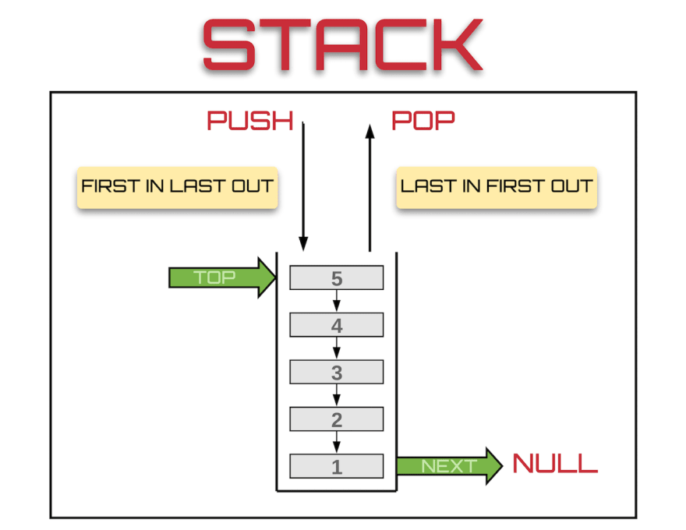
7
Stack
Stack is a linear data structure which follows a particular order in which the operations are performed. The order may be LIFO(Last In First Out) or FILO(First In Last Out).
Source: https://res.cloudinary.com/practicaldev/image/fetch/s--s1Qbl8Gf--/c_limit%2Cf_auto%2Cfl_progressive%2Cq_auto%2Cw_880/https://thepracticaldev.s3.amazonaws.com/i/mwcwre09s12vqa3gvl7a.png

Slide 9
8
Stack operations
Two Basic operations are performed in the stack:
PUSH: Inserting an element into the stack
POP: Deleting an element from the stack
When data is PUSHed onto stack
Check the status of stack by following functionality is added to stacks −
peek() − Get the topmost item of the stack, without removing it.
isFull() − check if stack is full.
isEmpty() − check if stack is empty.

Slide 10

9
How to understand stack practically?
There are many real life example of stack . Considered the sample example of plates stacked over one another in canteen.
The plate which is at the top is the first one to remove i.e. the plate which has been placed at the bottom position in the stack for the longest period of time.
So, it can be simply seen to follow LIFO/FILO order.

Slide 11
10
Implementation
There are two ways to implement a stack :
Using Array
Using Linked List

Slide 12
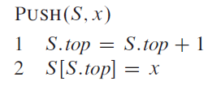
11
Push Operation
Step 1 − Checks if the stack is full.
Step 2 − If the stack is full, produces an error and exit.
Step 3 − If the stack is not full, increments top to point next empty space.
Step 4 − Adds data element to the stack location, where top is pointing.
Step 5 − Returns success.

Slide 13
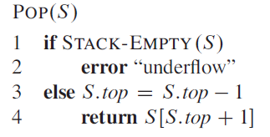
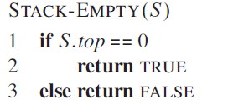
12
Pop Operation
Step 1 − Checks if the stack is empty.
Step 2 − If the stack is empty, produces an error and exit.
Step 3 − If the stack is not empty, accesses the data element at which top is pointing.
Step 4 − Decreases the value of top by 1.
Step 5 − Returns success.

Slide 14
Linked list implementation of stack
13
Linked list allocates the memory dynamically.
The top most node in the stack always contains null in its address field. Lets discuss the way in which, each operation is performed in linked list implementation of stack.

Slide 15
push - Inserting an element into the Stack
14
We can use the following steps to insert a new node into the stack...
Step 1 - Create a newNode with given value.
Step 2 - Check whether stack is Empty (top == NULL)
Step 3 - If it is Empty, then set newNode → next = NULL.
Step 4 - If it is Not Empty, then set newNode → next = top.
Step 5 - Finally, set top = newNode.

Slide 16
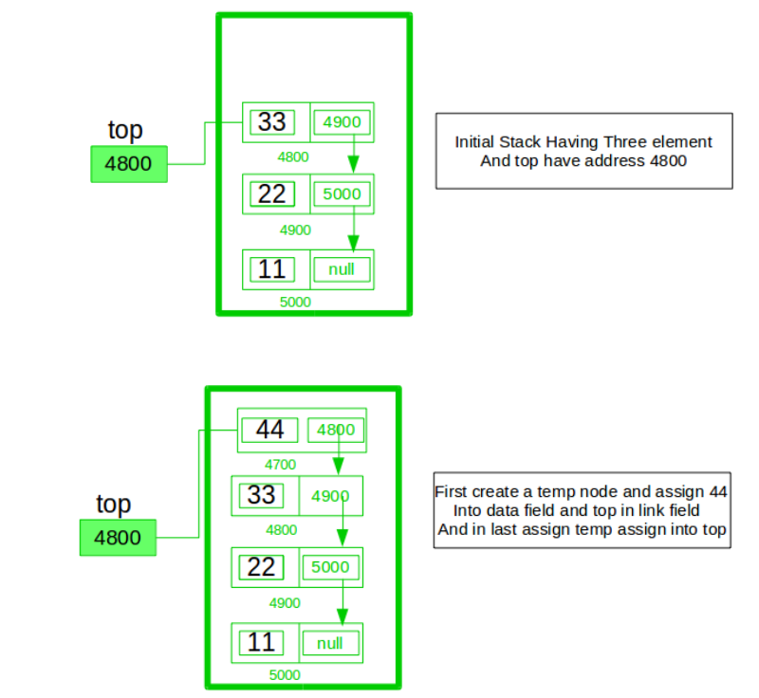
15

Slide 17
16
pop() - Deleting an Element from a Stack
We can use the following steps to delete a node from the stack...
Step 1 - Check whether stack is Empty (top == NULL).
Step 2 - If it is Empty, then display "Stack is Empty!!! Deletion is not possible!!!" and terminate the function
Step 3 - If it is Not Empty, then define a Node pointer 'temp' and set it to 'top'.
Step 4 - Then set 'top = top → next'.
Step 5 - Finally, delete 'temp'. (free(temp)).

Slide 18
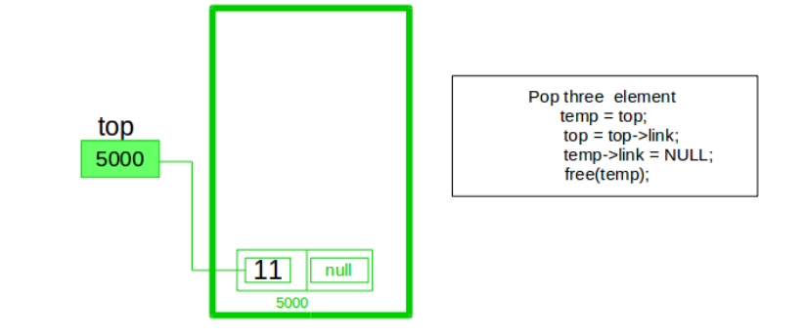
17
Pop Operation

Slide 19
display() - Displaying stack of elements
17
We can use the following steps to display the elements (nodes) of a stack...
Step 1 - Check whether stack is Empty (top == NULL).
Step 2 - If it is Empty, then display 'Stack is Empty!!!' and terminate the function.
Step 3 - If it is Not Empty, then define a Node pointer 'temp' and initialize with top.
Step 4 - Display 'temp → data --->' and move it to the next node. Repeat the same until temp reaches to the first node in the stack. (temp → next != NULL).
Step 5 - Finally! Display 'temp → data ---> NULL'.

Slide 20
17
Applications of Stack
The simplest application of a stack is to reverse a word. You push a given word to stack - letter by letter - and then pop letters from the stack.
There are other uses also like:
Parsing
Expression Conversion(Infix to Postfix, Postfix to Prefix etc)

Slide 21
17
Summary
Arrays:
Operations on arrays.
Types of an array
Stacks:
Operations and basic features of stack
Implementation of stack
Application of stack

Slide 22
18
Next Lecture
- Queue

Slide 23
19
Quiz
Which of these is NOT a valid stack operation? A) Push B) Pop C) Peek/Top D) Insert at index
Which condition indicates a stack overflow in a static array implementation? A) top < 0 B) top == size - 1 C) top == 0 D) top == NULL

Slide 24
20
References/ Articles/ Videos
Text books:
Cormen, Leiserson, Rivest, Stein, “Introduction to Algorithms”, Prentice Hall of India, 3rd edition 2012. problem, Graph coloring.
Horowitz, Sahni and Rajasekaran, “Fundamentals of ComputerAlgorithms”, University Press (India), 2nd edition
Websites:
https://www.tutorialspoint.com/data_structures_algorithms/array_data_structure.htm
https://gradeup.co/stacks-i-12d755b7-c59a-11e5-9776-de767a2dfd2a
https://www.geeksforgeeks.org/stack-data-structure/
https://www.javatpoint.com/ds-linked-list-implementation-of-stack#:~:text=Linked%20list%20allocates%20the%20memory,successor%20node%20in%20the%20stack.

Slide 25
21
Faculty-curated videos, NPTEL, Coursera, LinkedIn, or other relevant learning resources
https://onlinecourses.nptel.ac.in/noc23_cs96/preview
https://nptel.ac.in/courses/106106131
https://nptel.ac.in/courses/106106208
https://www.linkedin.com/learning/learning-algorithms
https://archive.nptel.ac.in/courses/106/102/106102064/

Slide 26
23
Class-Wise Feedback

Slide 27
24
Thank You
For queries
Email: richa.e11307@cumail.in

